Slide 1


GAME DEVELOPMENT WITH UNITY PROJECT NO: 231402
BY: ELAD MOSHE & OMER GABAY INSTRUCTOR: MOSHE SULAMY

Slide 2
Are You…
A virtual reality enthusiast?
Someone who enjoys simulation and management games?
The kind of person who likes playing in a race against the clock?

Slide 3

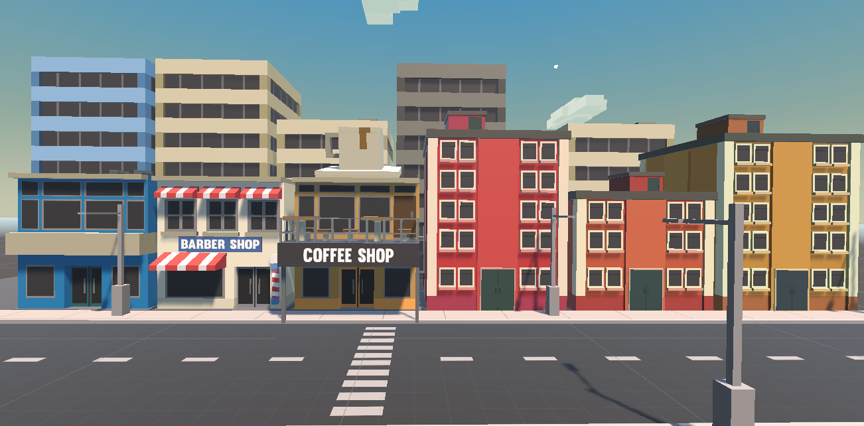

Life Just Gave You Lemons…
Lemon Inc is a charming, engaging and interactive virtual reality experience where the player is placed in a bustling city and is in charge of managing their own lemonade stand!

Slide 4


Time To Make Lemonade!
Receive orders!
Prepare them just in time!
Call out the names of your customers and serve!
That’s right!
The game incorporates voice commands, making it a uniquely immersive experience.

Slide 5
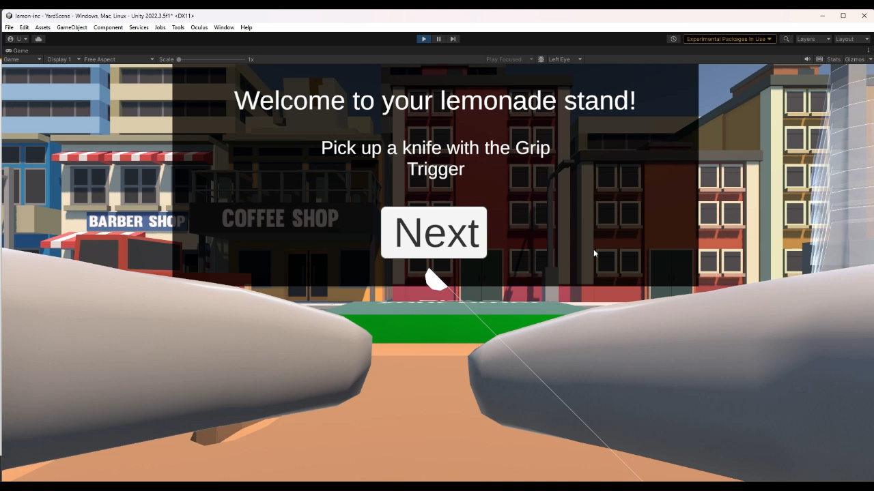
VIDEO HERE

Slide 6
A Zestful Game Loop
Receive Orders
Prepare: Slice, Squeeze, Sweeten
Call out customer’s name
Serve the matching items
Collect cash and grow your business

Slide 7



Citrus-Powered Tech
This game was created using the Unity Game Engine and the XR Toolkit
All vocal interactions are processed using Meta’s Wit.AI natural language interface for applications
Developed for Meta Quest 2

Slide 8

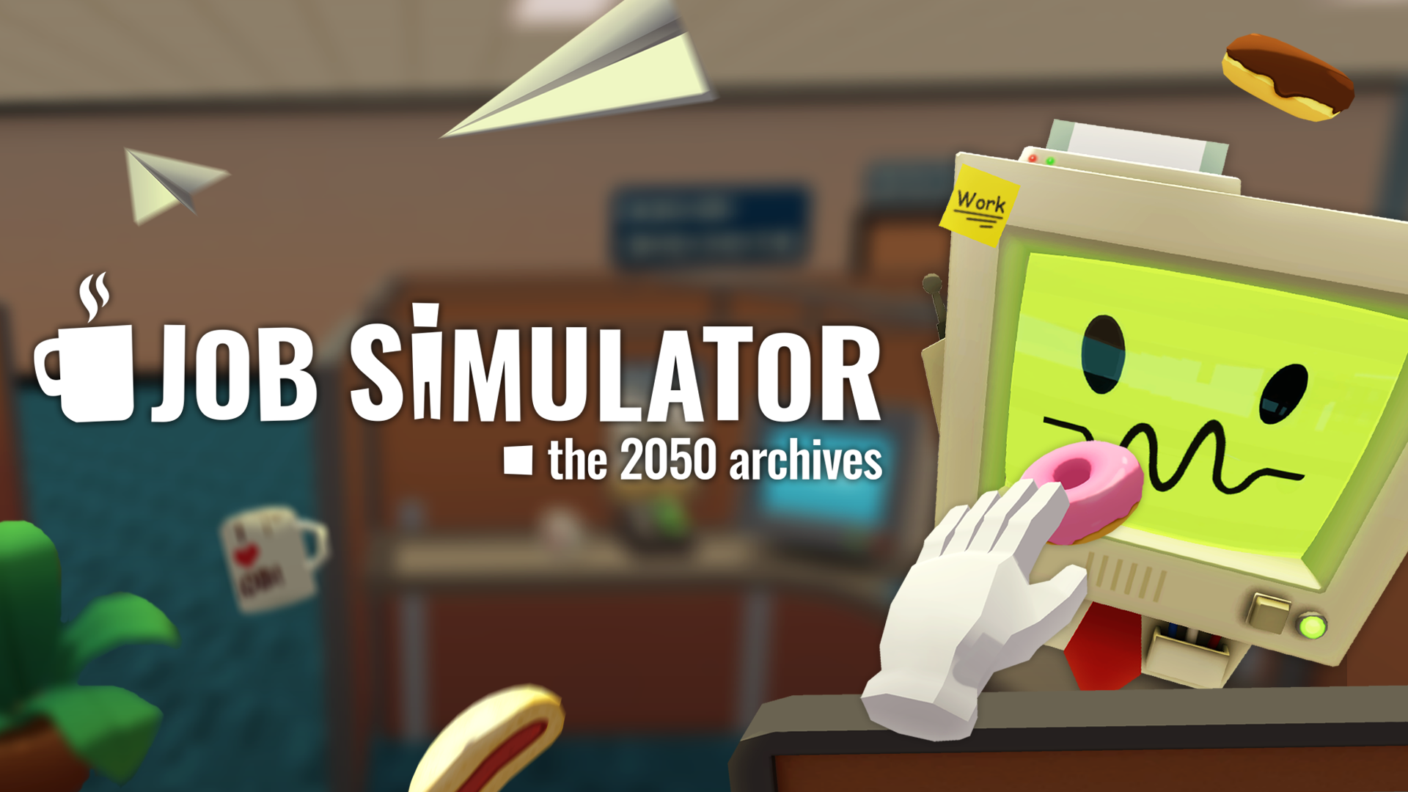
Our Inspiration
Games such as:
Overcooked – Features fast-paced meal preparation
Job Simulator – Another great virtual reality experience with a more relaxed approach
Lemon Inc stands out because it combines:
Virtual reality
Voice commands
Time sensitivity

